Slide 1
Pericalm® Checklist™
PeriCALM Checklist
Emily Hamilton MDCM
SVP Clinical Research

Slide 2
Healthcare Is Information-Dependent
Collect, analyze, share and inform
Consistent, timely, complete
PeriCALM Checklist: synergy of IT intervention and clinical practice
Enhance human efficiency
Consistent recognition of impending problems

Slide 3
The Problem: Oxytocin Misuse is Common but Potentially Hazardous
Relevance
Oxytocin is a high alert drug ³
Oxytocin misuse is common
US Birth rate¹
3.98 million annually
IV Oxytocin: drug used to enhance contractions ²
~50% of women in labor
Dose is adjusted often due to highly variable and rapid patient response
Excessive contractions decrease oxygen delivery to the baby
In birth-related brain injuries
Oxytocin misuse ⁴⁻⁷ 45%-71%
Settlements made in
70% legal suits involving oxytocin ¹
Very costly median $1.32 million ⁴
upper range $20-35 million ⁸

Slide 4
Underlying Causes: Current Management Prone to Human Error
Human Factors
System factors
Reality
Oxytocin effect on labor generally very useful
Minor protocol deviations usually well tolerated
Favors creeping deviation from standards
Nurses expected to manually count the number of contractions every 15-30 min and adjust drug levels
In 2014 HCA study, compliance with a simple six-point protocol associated with lower rates of CS and complications
BUT
Noncompliance rate nearly 60% ⁹
Non Compliance

Slide 5
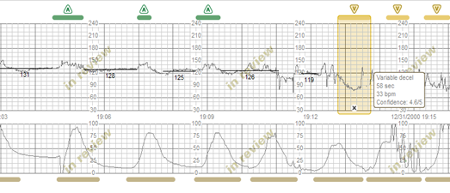
Solution: PeriCALM CheckList
Real-time tracing analysis
NIH-validated
Objective: no bias, no bad days, no distractions, not training-dependent
CheckList
Identifies concerning combinations
Items and thresholds - configurable by the individual institution
Intuitive displays – recognize issues at a glance!

Slide 6
PeriCALM CheckList: Longer Tracing Displays
30 min
4 hours

Slide 7
PeriCALM CheckList: NIH-Validated Pattern Recognition
Labels
Accelerations
Decelerations
Baseline
Contractions

Slide 8
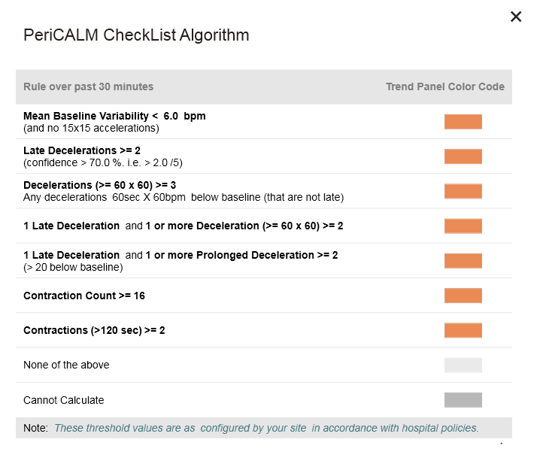
Sample Checklist

Slide 9
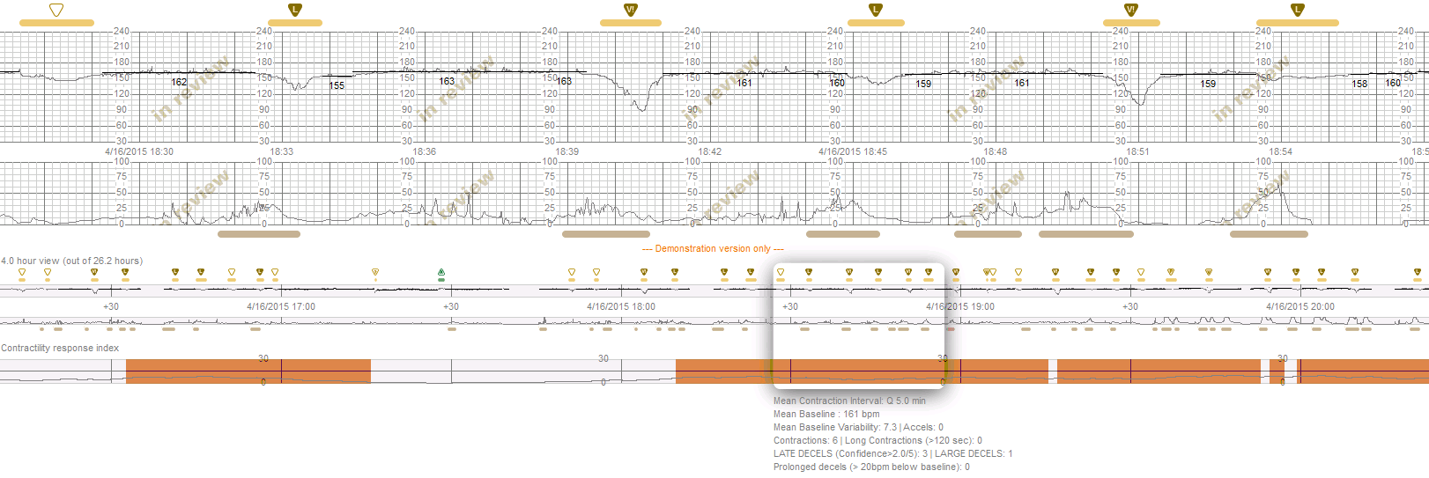
PeriCALM CheckList: Displays with Analysis
4-Hour Color Coded
CheckList Status
Negative
Positive
Calculations

Slide 10
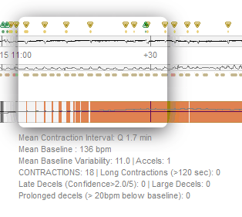
Positive Items are in CAPS

Slide 11
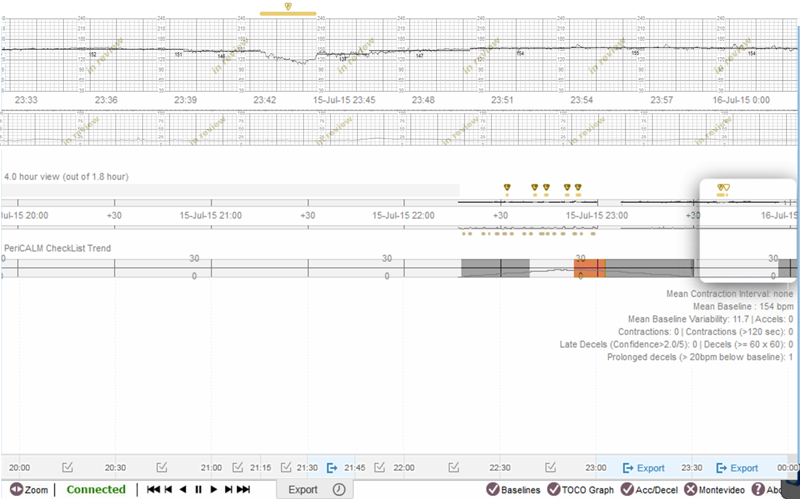

Slide 12
Exported
Available for Export

Slide 13
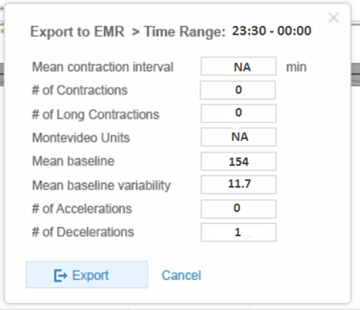

Slide 14
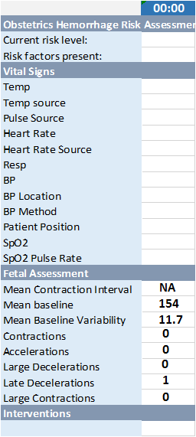
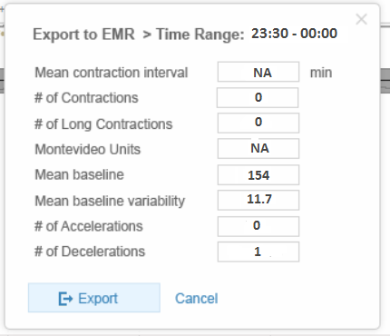
Export to EMR
PeriCALM Patterns/CheckList Confirmation
Epic Flowsheet
Configurable list to export just the fields you want to export to the EMR
Nurse can override any field
HL7
0
Export Button will export the list to the EMR
Respective fields will have to be created/adapted in the EMR build
0
0
0
0
0

Slide 15
Clinical Impact
Reduction in incidence and duration of excessive contraction rates

Slide 16
Published Results: Better Outcomes with Oxytocin Checklist Compliance

Slide 17
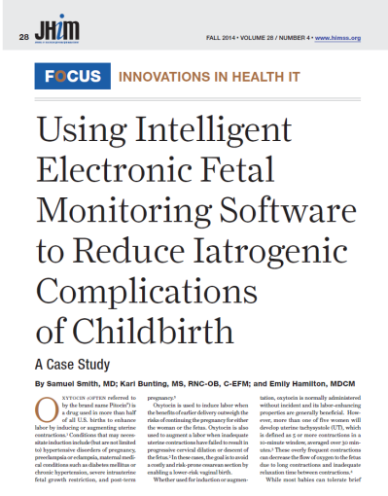
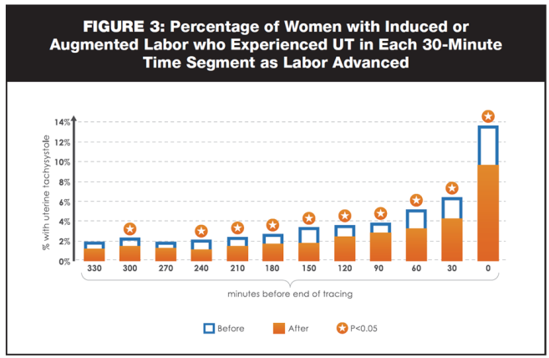
Published Results: Reduction in Uterine Tachysystsole
10,518 patients
before and after software introduction¹⁰
In Patients with oxytocin
36.5% Reduction in
% of total time in UT *
UT = uterine tachysystole
> 15 contractions in 30 minutes
* P<0.05

Slide 18
Conclusions
Current Methods
PeriCALM Checklist
Objective, fact-based automated
Resistant to remedial education
Error can have high consequences
Promotes standardization and efficiency
Demonstrable results
Subjective assessments
Prone to human error
Relentlessly vigilant
Intuitive displays

Slide 19
References
1. Hamilton BE Ph D, Martin JA, Osterman MJ M H S, Curtain SC M A. Births: Preliminary Data for 2014. Natl Vital Stat Rep. 2015 Jun;64(6):1-19.
2. Zhang J, Branch DW, Ramirez MM, Laughon SK, Reddy U, Hoffman M, Bailit J, Kominiarek M, Chen Z, Hibbard JU. Oxytocin regimen for labor augmentation, labor progression, and perinatal outcomes. Obstet Gynecol. 2011 Aug;118(2 Pt 1):249-56.
3. Institute for Safe Medical Practices. High alert medications. [Accessed February 20, 2011]; Available at: http://www.ismp.org/Tools/institutionalhighAlert.asp
4. Clark SL, Belfort MA, Dildy GA, Meyers JA. Reducing obstetric litigation through alterations in practice patterns. Obstet Gynecol. 2008 Dec;112(6):1279-1283.
5. Berglund S, Grunewald C, Pettersson H, Cnattingius S. Severe asphyxia due to delivery-related malpractice in Sweden 1990-2005. BJOG. 2008 Feb;115(3):316-323
6. Jonsson M, Nordén SL, Hanson U. Analysis of malpractice claims with a focus on oxytocin use in labour. Acta Obstet Gynecol Scand. 2007;86(3):315-319.
7. Canadian Medical Protective Association. Managing the Risks of Labour Induction. CMPA Perspective. March, 2014. https://www.cmpa-acpm.ca/-/managing-the-risks-of-labour-induction Accessed online October2, 2015.
8. Greve P. Labor Pains: Liability Trends in Obstetrics. Willis HealthCare Practice HealthTrek, 2008;September.
9. Clark SL, Meyers JA, Frye DK, Garthwaite T, Lee AJ, Perlin JB. Recognition and response to electronic fetal heart rate patterns: impact on newborn outcomes and primary cesarean delivery rate in women undergoing induction of labor. Am J Obstet Gynecol. 2015 Apr;212(4):494.e1-6.
10. Smith S, Bunting K, Hamilton E. Using Intelligent Electronic Fetal Monitoring Software to Reduce Iatrogenic Complications of Childbirth. JHIM. 2014;28; 4:28-33.

Slide 20
Thank You

Slide 21
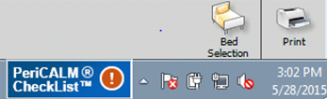
Dynamic Tool Bar Icon
Tool Bar Icon

Slide 22
Positive Status with Pop up Notification
Notification
Tool Bar Icon

Slide 23
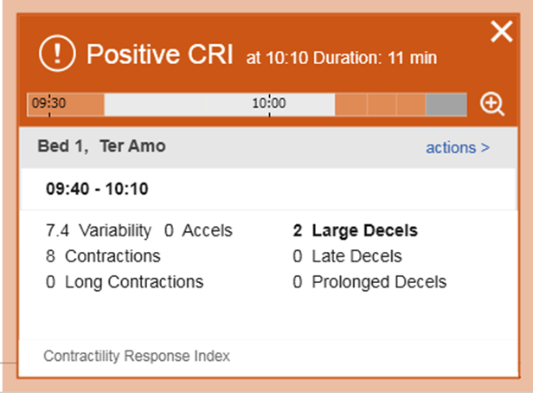
PeriCALM CheckList: Live Status Notification @ Bedside & Nursing Stations
Central Station
Bedside

